Slide 1
UBER Clone App

Slide 2
Fonctionnalité
1 / S17 Afficher la Position réel en coordonnées GPS
2/ S18 S19 Afficher la Position réel en coordonnées Postal
3/ S25 afficher la ligne de parcours,

Slide 3
17. get user current location - flutter google map
geolocator 6.1.1
void locatePosition() async
GoogleMap()
bottomPaddingOfMap

Slide 4
18. enable GeoCoding Api and Reverse GeoCoding
Geocoding is the process of converting addresses (like a street address) into geographic coordinates (like latitude and longitude), which you can use to place markers on a map, or position the map.
Reverse geocoding is the process of converting geographic coordinates into a human-readable address.
Geocoding API

Slide 5
19. reverse geocoding and display address
http: ^0.12.2
requestAssistant,dart
class RequestAssistant
static Future<String> searchCoordinateAddress(Position position, context) async
void locatePosition() async,
class AssistantMethods

Slide 6
20. setting Data Provider Class and save Current Location Address
provider: ^4.3.2+2
class AppData extends ChangeNotifier / Provider Pack
class Address
Main.dart : This widget is the root of your application.
return ChangeNotifierProvider( create: (context) => AppData(),

Slide 7
21. search and create destination page

Slide 8
22. enable google places api - auto complete search
Place Autocomplete
The Place Autocomplete service is a web service that returns place predictions in response to an HTTP request. The request specifies a textual search string and optional geographic bounds. The service can be used to provide autocomplete functionality for text-based geographic searches, by returning places such as businesses, addresses and points of interest as a user types.

Slide 9
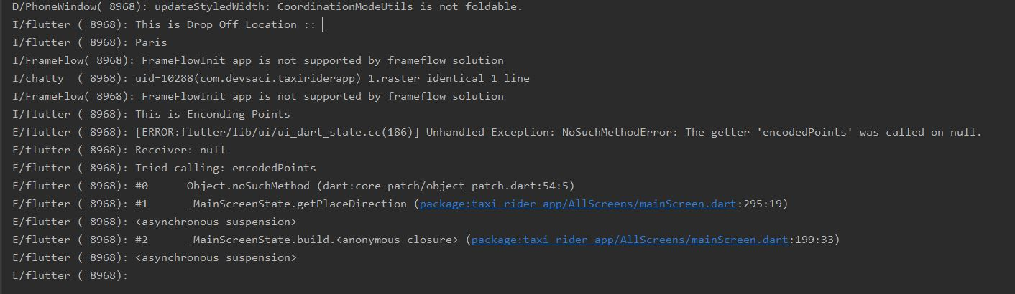
25. get direction from pickup to dropoff location using google direction api

Slide 10
26. draw polyline on map & fit polyline on map – LatLng Bounds & add Markers Circles
flutter_polyline_points 0.2.4
This package contains functions to decode google encoded polyline string which returns a list of co-ordinates indicating route between two geographical position

Slide 11
31. create ride request and cancel ride request

Slide 12
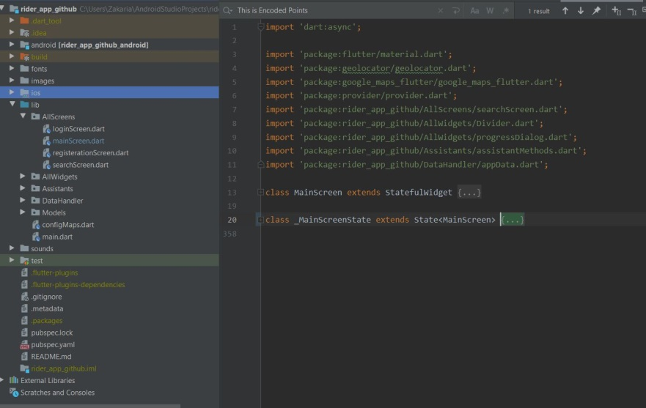
Class UML
MainScreen file
class MainScreen extends StatefulWidget
class _MainScreenState extends State<MainScreen>

Slide 13
Taxi_Driver_App
Fonctionnalité :

